Slide 1
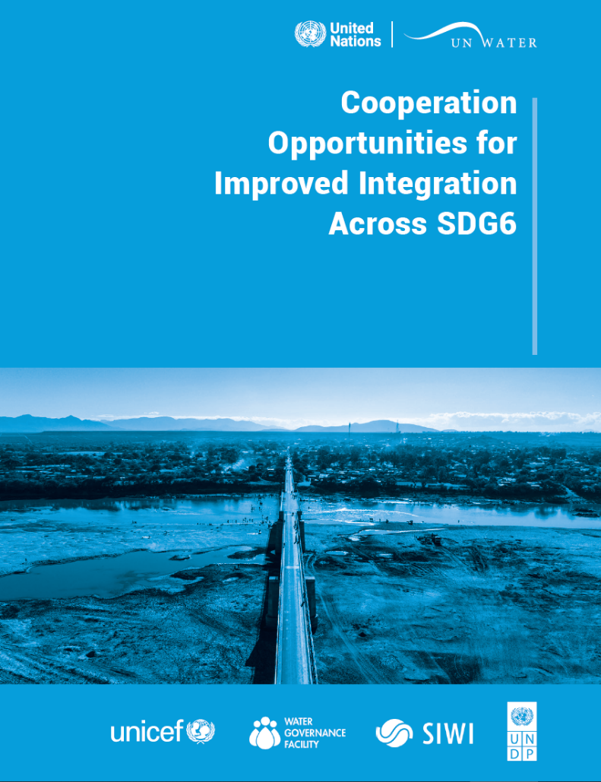


Cooperation Opportunities for Improved Integration
22nd February 2023

Slide 2
Agenda
Introduction – Ms. Marianne Kjellén (UNDP)
Presentation of the report – Mr. Robin Ward and Mr. Alejandro Jiménez (SIWI)
Case studies
  UNICEF experiences in East Asia-Pacific region (recorded) – Ms. Silvia Gaya (UNICEF)
  Comoros case study - Mr. Said Mohamed Nassur (Government of Comoros)
  Water Roadmaps – Ms. Virginie Gillet (FAO)
  WASH and WRM integration: Putting theory into practice - Mr. Colin Herron (GWP)
Panel discussion (UNICEF, UNDP, SIWI, FAO, GWP)
  What would be the next steps for implementation of this framework?
  What challenges we need to overcome and what opportunities lie ahead?
Closing Remarks – Ms. Farai Tunhuma (UNICEF)
Moderation- Jorge Alvarez Sala (UNICEF)

Slide 3
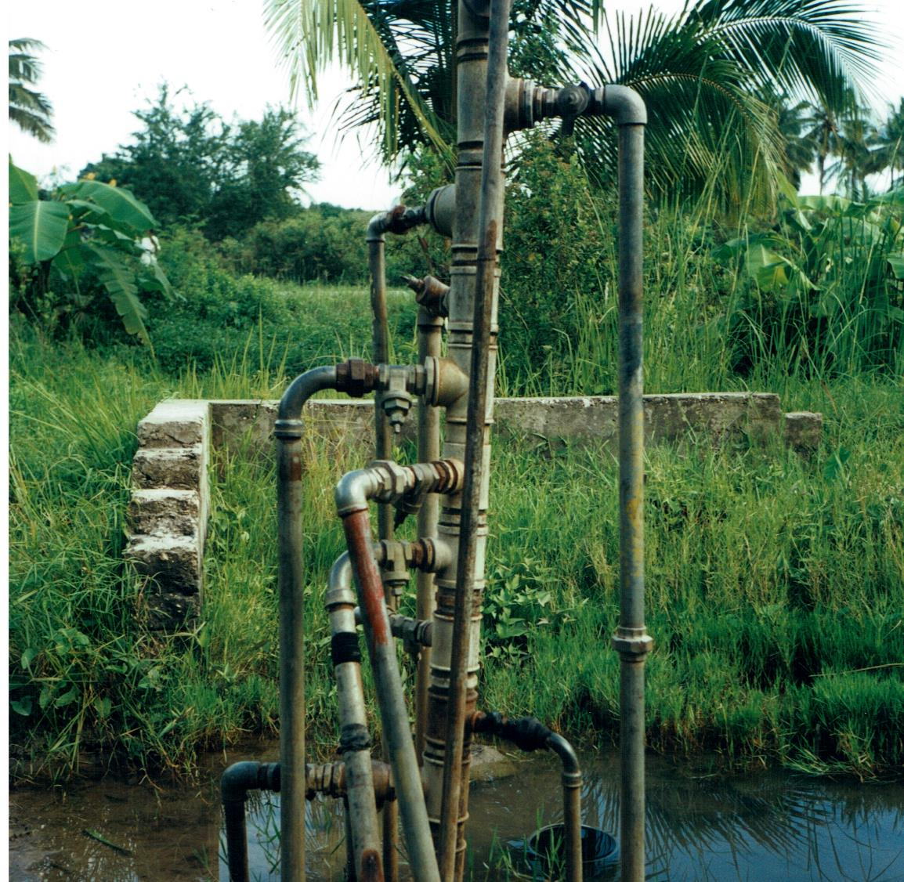
Cooperation Opportunities for Improved Integration:
Introduction
& background
Marianne Kjellén, Senior Water Advisor,
United Nations Development Programme (UNDP)

Slide 4
Presentation of the report
10min

Slide 5

Cooperation Opportunities for Improved Integration Across SDG6
Report addresses the institutional fragmentation between WRM and WASH
The report aims to assist water professionals to overcome this fragmentation and to make a transformative shift towards integrated and holistic approaches to addressing the water crisis and advancing global agendas.
Notes:
In this presentation, I will take you through some of the findings from a study, called “Cooperation Opportunities for Improved Integration Across SDG 6”, carried out as part of the Accountability for Sustainability partnership between UNICEF, and the UNDP-SIWI Water Governance Facility.
In this report we present a proposed cooperation framework, that will guide practitioners and policy makers to identify the existing silos and fragmentation between WASH, water for domestic needs, and WRM, water for other human and environmental needs, but also to understand the linkages and raise awareness on potential concrete opportunities for collaboration.
I won’t go into detail about the fragmentation, but suffice to say that there are many examples, and one illustrative case is that UN-Water coordinates on water issues with 33 United Nations agencies and organisations, each with a different stake in water. This fragmented set-up has many detrimental outcomes, from conflicting agency priorities and inefficiencies, to unmet needs.
This report is intended to assist water practitioners and policymakers to overcome this fragmentation, not by advocating for one big department with everyone in it, or one big multisectoral group, but to expanding coordination mechanisms and look for synergies to achieve more equitable and effective policy outcomes to address the water crisis.

Slide 6



Rationale behind WRM-WASH Cooperation
Each area facilitates positive outcomes in the other area
Sustainable safely managed WASH
Water resources conservation
Good WRM helps ensure a sufficient quantity and quality of water resources for water and sanitation services, at all times, for all
WASH contributes to the conservation and protection of water resources and the environment through efficient and safely managed water and sanitation services
Notes:
A key message that we want to convey through this study is that the cooperation between WASH and WRM is necessary.
Each area has an important role to play to facilitate the positive outcomes in the other area.
We need to have enough quantity and quality of water in order to have resilient, sustainable, and safely managed WASH services
To achieve this we need effective management of the water resources that includes environmental flows, agriculture, irrigation, energy, and industry.
Similarly, a safe and biodiverse ecosystem requires adequate sanitation.
Improved access and proper treatment of solid wastewater, together with measures such as water protection, can reduce negative impacts of sanitation on ecosystems,.
As such, WASH can contribute to conservation and protection of water sources and the environment through efficient and safely managed services.

Slide 7
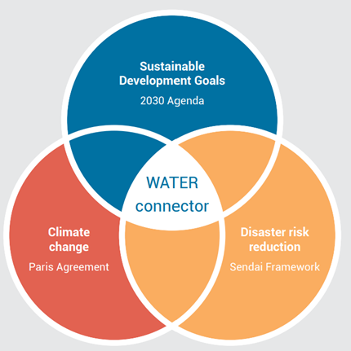
WRM-WASH Cooperation & Global Agendas
Ensuring climate resilient WASH services
Water resources monitoring and planning, water demand management, recycle and reuse
Increased wastewater treatment (6.4), good ambient quality (6.3) of freshwater resources → secure access to safely managed drinking water services (6.1)
Safely managed sanitation (6.2) → improved ambient water quality (6.3) → protect water related ecosystems (6.6)
IWRM at levels (6.5) –synergies across SDG 6
Ensuring basic WASH service continuity during disasters
Drought and flood preparedness measures, EWS, protection from water-related disasters.
Notes:
Another critical point on the need for this cooperation is that a greater alignment of policies and practices across WASH and water resources management can support greater global policy coherence.
Because of the central role of water in many sectors, effective cooperation between stakeholders contributes to advancing global agendas, and here we see three examples of the role of water as a connector among the global commitments adopted in 2015. The first is Sustainable Development Goals 6.
SDG – we see the integration of WRM-focused and WASH-focused indicators and how they depend on each other.
The importance of ensuring the availability of a sufficient quantity (SDG6.4) and good ambient quality (SDG6.3) of freshwater resources in order to secure access to safely managed drinking water services (SDG6.1)
Achieving access to sanitation that is safely managed (SDG6.2), leading to improved ambient water quality (SDG6.3), which contributes to protecting water-related ecosystems (SDG6.6).
SDG 6.5 – integrated WRM under the right governance structures, which can lead to synergies across the whole of SDG6.
CC and the Paris Agreement
We see the need to ensure climate resilient WASH services through climate change adaptation
Which will further lead to understanding of water resources, through improved monitoring, and planning for mitigating against climate risks and uncertainty in potential changes to water resources quantity, accessibility, and quality.
DRR and the Sedai Franmework
We need to ensure at least basic WASH service continuity during disasters
Through e.g. drought and flood preparedness measures, EWS, protection from water-related disasters.

Slide 8
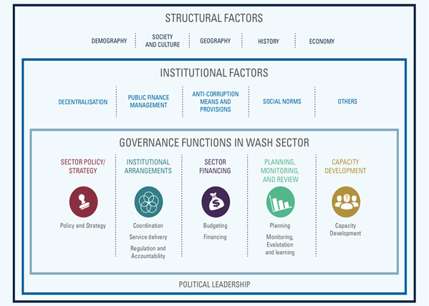
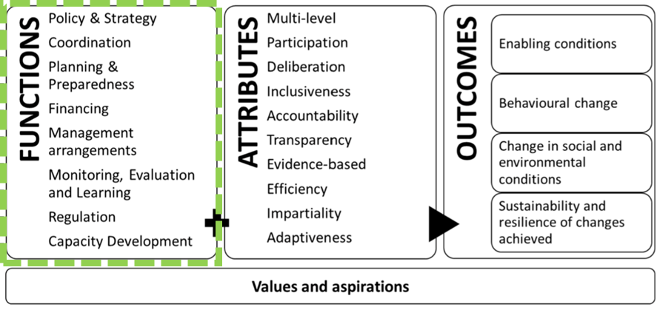
WASH Governance and Water Resources Governance
The Water Governance Framework, as a combination of functions, attributes, and outcomes, with wider applicability across water disciplines to include water resources
UNICEF 2016. Strengthening enabling environment for water, sanitation, and hygiene (WASH) - Guidance Note. New York,: UNICEF.
Jimenez et al. 2020. Unpacking Water Governance: A Framework for Practitioners
Notes:
But how can countries identify these existing gaps, policy and institutional fragmentations or possible opportunities for cooperation?
Integrating the management and development of WASH and WRM processes requires a greater alignment of aims and strategies, which are organized by structural and institutional factors, and functions.
For WASH particularly, the WASH enabling environment framework as shown here has become widely adopted to strengthen the governance of the sector, by focusing on key functions and “building blocks” of the WASH systems. This has been further adapted to the operational water governance framework, to include water resources
This illustrates the set of core governance functions, i.e., key processes that are performed, in various forms and to varying extents and quality, for the organised development and management of water resources as well as services in a country, thus standing relevant for both.
But we need to focus on the functions, and particularly the subfunctions, to identify the cooperation areas, as well as the differences between WASH and WRM.
As an example, the regulation function for WASH includes regulation of water and sanitation service standards, tariffs, service quality, consumer protection; and for WRM it includes economic and environmental regulation such as: setting water abstraction limits, water discharge and ambient water quality standards and control.
However, it was investigating the functions and sub-functions, looking for areas of overlap for WRM and WASH, which was the starting point for the study to design the WRM-WASH Cooperation framework.

Slide 9
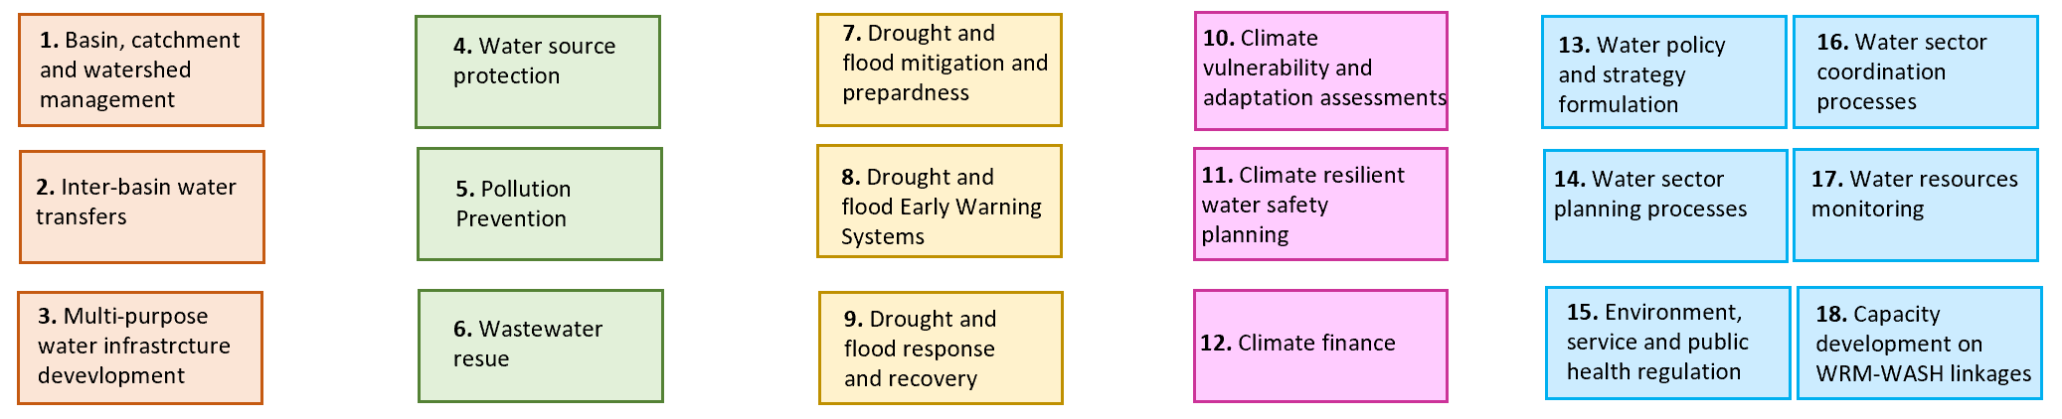
WRM-WASH Cooperation Areas and Joint Outcomes
AREAS OF COOPERATION
FIVE JOINT OUTCOMES
Notes:
Through this analysis 18 “Cooperation Areas” were identified. They reflect areas where both sectors must cooperate for success, categorised into five broad joint outcomes, which are achieved by improving cooperation in the 18 areas. The end outcome is of course to ensure safe, clean, and sufficient water supply for all, in a way that respect the integrity of environmental flows.
Although all five joint outcomes are closely interlinked and interdependent in their contributions to achieving a long-term impact, they reflect clear directions for sectors to align commitments, and for all relevant actors to take cooperative action.
The study looks into best practices for each of these five joint outcomes.

Slide 10
Joint Outcome 1: Equitable water resources allocation
Cooperation Area 1:
Basin, catchment, and watershed management
Contributing to the fulfilment of the Human Rights to Water and Sanitation (HRWS) and the Human Right to a Healthy Environment (HRHE)
Meeting the needs of multiple water uses (e.g. water-dependent ecosystems and species, agriculture and irrigation, aquaculture, industrial and commercial use, water-based recreation, and traditionally owned cultural values).
    Cooperation Area 2:
    Inter-basin water transfers
    Cooperation Area 3:
    Multi-purpose water infrastructure development
Notes:
Basin, catchment, and watershed management: where water allocation and water quality needs of WASH services need to be adequately considered in the context of the competing demands of different user groups
Inter-basin water transfers: cooperation, planning and executing the transfer of raw untreated water, treated water and/ or wastewater between basins or within a basin to resolve imbalances in supply and demand, while not compromising water needs or damaging the environment in either basin.
Multi-purpose water infrastructure development: plan, design, finance and execute infrastructure projects of different sizes that factor in multiple uses of water to ensure that synergies and efficiencies are exploited.
Cooperation at every step of decision-making for water resources planning and allocation processes can contribute to the fulfilment of the HRWS and the HRHE, while also meeting the needs of multiple water uses, such as water-dependent ecosystems and species, agriculture and irrigation, aquaculture, industrial and commercial use, and traditionally owned cultural values.

Slide 11
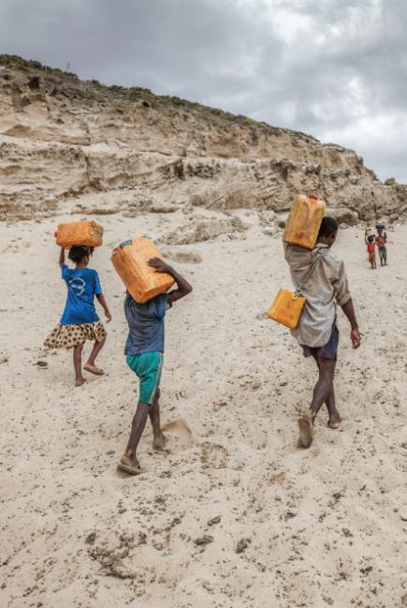
Joint Outcome 1: Equitable water resources allocation
Opportunities to cooperate for equitable water resources allocation
Support meaningful WASH engagement in basin, catchment, and watershed management.
Make water resources monitoring data available to WASH service providers and vice versa.
Notes:
Raise awareness among non-WASH actors on the HRWS and build capacity on how to plan for, and implement, equitable water resource allocation and support community engagement in WASH and WRM
WRM to make water resources monitoring data available to WASH service providers, who should in turn make their data available – e.g. on flow, abstraction/discharge, and water quality to stimulate more robust basin, catchment and WASH services planning.
Cooperate to avoid the need for basin transfers and to avert negative impacts of basin transfers on the HRWS.

Slide 12
Joint Outcome 2: Sustainable water management
Cooperation Area 4:
Source water protection
Safeguarding water resources:
through agreed criteria in decisions that are related to the allocation of water resources to different uses;
in a fit-for-purpose manner;
that respects the needs of current and future users to the extent that this is feasible;
without causing environmental degradation.
    Cooperation Area 5:
    Pollution prevention
    Cooperation Area 6: Wastewater use
Notes:
Source water protection: relates to the protection and restoration of water sources used by WASH service providers, sometimes linked to Water Safety Planning (WSP) or Sanitation Safety Planning (SSP), and this requires cooperation between WASH service providers, upstream landowners and communities, other potentially polluting entities, and WRM authorities.
Pollution prevention: Cooperation is critical to protect and conserve water related ecosystems as well as downstream drinking water sources
Wastewater use: Improve conservation of water resources through wastewater reuse, and particularly for agricultural irrigation, to reduce dependence on freshwater sources.
Safeguarding water resources in these ways is needed using appropriate criteria related to the allocation of water resources which takes into account both current and future users without damaging the environment.

Slide 13
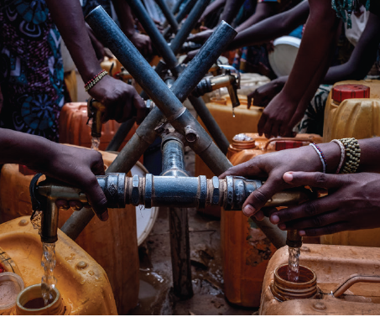
Joint Outcome 2: Sustainable water management
Opportunities to cooperate for sustainable water management
Realise the huge potential of wetlands to protect water supplies and to treat and put wastewater to productive use
Scale up WASH support to source water protection schemes with water supply and watershed co-benefits.
Notes:
Introduce and scale up the successful Source to Sea approach
Scale up catchment management aspects of climate resilient Water Safety Planning by engaging WRM institutions and water resources user groups in hazard and risk assessments of drinking water source catchment
Ensure that wastewater tariffs factor in the costs of mitigating the negative impacts on the environment (the “polluter pays” principle) and take longer term solutions such as wastewater reuse for pollution prevention.

Slide 14
Joint Outcome 3: Drought and flood disaster resilience
Cooperation Area 7:
Drought and flood mitigation and preparedness
Cooperation helps to prevent water hazards from becoming disasters through:
averting localized flooding and pollution from poor WASH services,
helping to continue delivering services when hazards strike, and
aiding recovery from extreme water-related events.
    Cooperation Area 8:
    Drought and flood monitoring and Early Warning Systems
    Cooperation Area 9:
    Drought and flood response and recovery
Notes:
In general cooperation can prevent hazards from becoming disasters, through…
Drought and flood mitigation and preparedness, monitoring and EWS: Cooperation to share data, from water resources monitoring networks, meteorological systems, but also from WASH service providers and utilities, to prepare robust preparedness strategies and plans to ensure continuity of WASH services during disasters.
Drought and flood response and recovery: During onset to enacting short-term mitigation actions (e.g., flood control to protect WASH infrastructure) and aligning the operationalization of contingency plans, but most importantly during recovery and learning to build more resilient WASH services.

Slide 15
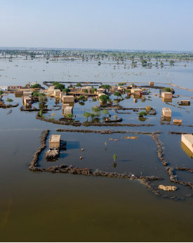
Joint Outcome 3: Drought and flood disaster resilience
Opportunities to cooperate for drought and flood disaster resilience
Improve EWS robustness through WASH datasets.
Bring together multi-sectoral stakeholders and develop a water sector wide resilience strategy.
Notes:
Ensure WRM-WASH cooperation in the development of drought policy and drought preparedness mechanisms, to ensure that the HRWS are prioritized.
NBS and Blue-green infrastructure solutions for flood mitigation and preparedness including wetland management for increased storage and flood retention.
Cooperation on improving EWS robustness through securing expanded hydrological datasets and data from WASH service providers
Bring together multi-sectoral stakeholders to develop a water sector-wide resilience strategy at the appropriate scale

Slide 16
Joint Outcome 4: Climate resilient WASH
Cooperation Area 10:
Climate vulnerability and adaptation assessments
Information sharing between WASH and WRM needed:
to allow for informed assessment of WASH service vulnerability,
in planning and developing climate-change policy, and;
In building the case for accessing climate finance.
    Cooperation Area 11:
    Climate resilient Water Safety Planning
    Cooperation Area 12:
    Climate finance
Notes:
Climate vulnerability and adaptation assessments and Climate resilient Water Safety Planning: As climate change adaptation essentially involves understanding and planning for changes in water resources quantity and quality to ensure WASH services are more resilient and sustainable, we need robust water resources information and vulnerability assessments to create CR-WSP to identify water availability hazards and related control measures, to respond to them and to implement these responses.
Climate finance: WASH actors to cooperate and associate with WRM actors in jointly accessing climate finance, particularly “adaptation” finance to build a strong climate rationale making the case for water resources related risks to basic WASH services and defining related adaptation strategies.

Slide 17
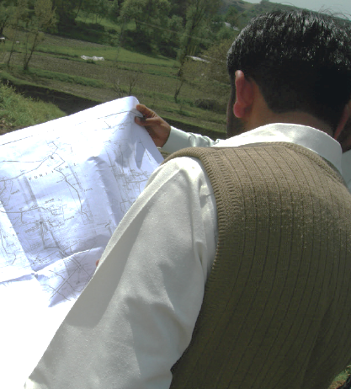
Joint Outcome 4: Climate resilient WASH
Opportunities to cooperate for climate resilient WASH
Exploit catchment management aspects of CR-WSP.
Explore climate mitigation finance opportunities on wastewater treatment.
Notes:
Exploit catchment management aspects of CR-Water Safety Plans to integrate water resources related climate hazards and risks into assessments,
Raise awareness of decision-makers on the lack of basic WASH and sanitation focus in climate adaptation finance
WRM and WASH to explore climate mitigation finance opportunities on wastewater treatment

Slide 18
Joint Outcome 5: Integrated water resources management and governance
Cooperation Area 13:
Water policy and strategy formulation
Greater cooperation needed:
in the formulation of policy and strategy and from enhanced, coordinated participation in the mechanisms that facilitate joint working and information-sharing.
in planning processes, in water resources monitoring, in regulation and in capacity development interventions at local, subnational, national and transboundary levels.
    Cooperation Area 14:
    Water sector coordination processes
    Cooperation Area 15:
    Water sector planning processes
    Cooperation Area 16:
    Water resources monitoring
    Cooperation Area 17:
    Environmental, service, and public health regulation
    Cooperation Area 18:
    Capacity development on WRM-WASH linkages
Notes:
Water policy and strategy formulation: Ensuring laws, policies, strategies, standards, and guidelines are responsive to each other
Water sector planning and coordination processes: this can include better drought and flood emergency response coordination
Water resources monitoring: needed for informed decision-making
Environmental, service, and public health regulation: this can help to mitigate impacts of wastewater and over-abstraction on the environment, preventing pollution and protecting public health
Capacity development on WRM-WASH linkages: is required to raise the importance of this topic, and in all joint WRM-WASH outcomes.

Slide 19
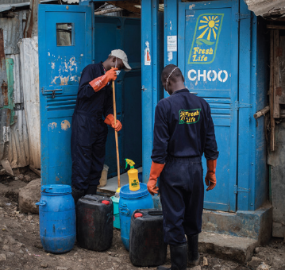
Joint Outcome 5: Integrated water resources management and governance
Opportunities to cooperate for IWRM and governance
Establishment of a high level inter-ministerial SDG 6 periodic review.
Establish a water resources monitoring taskforce (for WRM and WASH actors) on ambient water quality.
Notes:
Establishment of a high level inter-ministerial SDG 6 periodic review, similar to a JSR, could allow for more integrated WRM-WASH planning and coordination
Establish a water resources monitoring taskforce to be participated in by WRM and WASH actors, and build capacity in this area, especially on water quality monitoring, in order to rapidly scale up ambient water quality monitoring efforts.
Increase WRM staffing so that a Water Resources Officials have more time to spend working at district/provincial office level, where other water sub-sector and other sector officials commonly sit (WASH, agriculture etc.) to support capacity development on practical local level integration.

Slide 20
WRM-WASH Cooperation Areas and Joint Outcomes
AREAS OF COOPERATION
FIVE JOINT OUTCOMES
Notes:
Through this analysis 18 “Cooperation Areas” were identified. They reflect areas where both sectors must cooperate for success, categorised into five broad joint outcomes, which are achieved by improving cooperation in the 18 areas. The end outcome is of course to ensure safe, clean, and sufficient water supply for all, in a way that respect the integrity of environmental flows.
Although all five joint outcomes are closely interlinked and interdependent in their contributions to achieving a long-term impact, they reflect clear directions for sectors to align commitments, and for all relevant actors to take cooperative action.
The study looks into best practices for each of these five joint outcomes. We will see a few case studies of this later on, and during the group work you will be encouraged to share any examples of your own.

Slide 21
Conclusions
Cooperation and alignment between WASH and water resource management are necessary.
It is possible to overcome fragmentation with actions at the policy and institutional level.
Cooperation across sectors and actors needs to be scaled up.
Overcoming fragmentation requires commitment and strong leadership.

Slide 22

Launch of report – Cooperation Opportunities for Improved Integration Across SDG6
https://siwi.org/publications/cooperation-opportunities-for-improved-integration-across-sdg6/
https://www.unwater.org/publications/cooperation-opportunities-improved-integration-across-sdg6

Slide 23

Thank you

Slide 24
Case studies

Slide 25
Case studies
  Experiences in the East Asia and Pacific region (UNICEF)
  Comoros Water Code (Gov. of Comoros and UNDP)
  Water Roadmaps (FAO)
  WASH and WRM integration: Putting theory into practice (GWP)

Slide 26
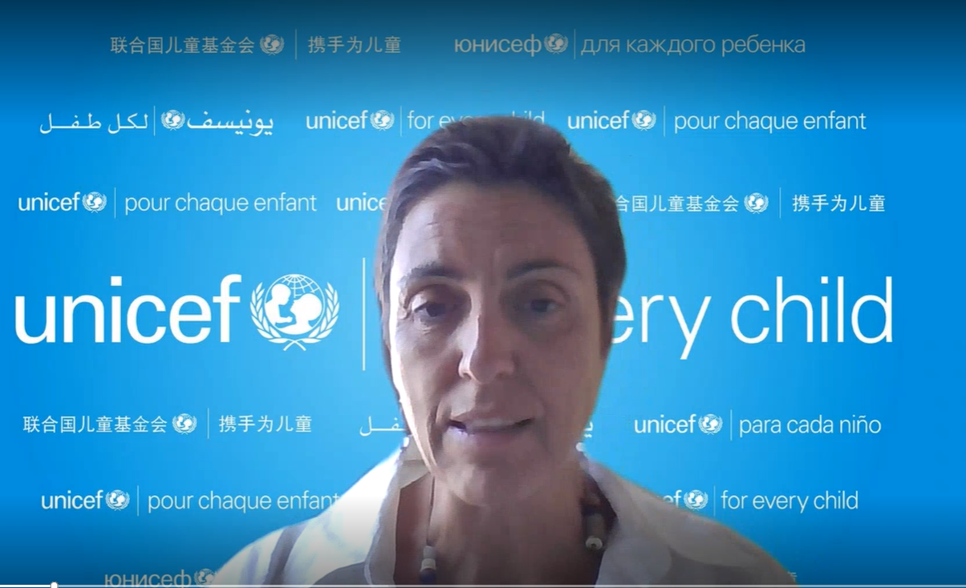
Case study 1
Experiences in East Asia Pacific Region

Slide 27
Case study 2
  Comoros Water Code (Gov. of Comoros and UNDP)

Slide 28
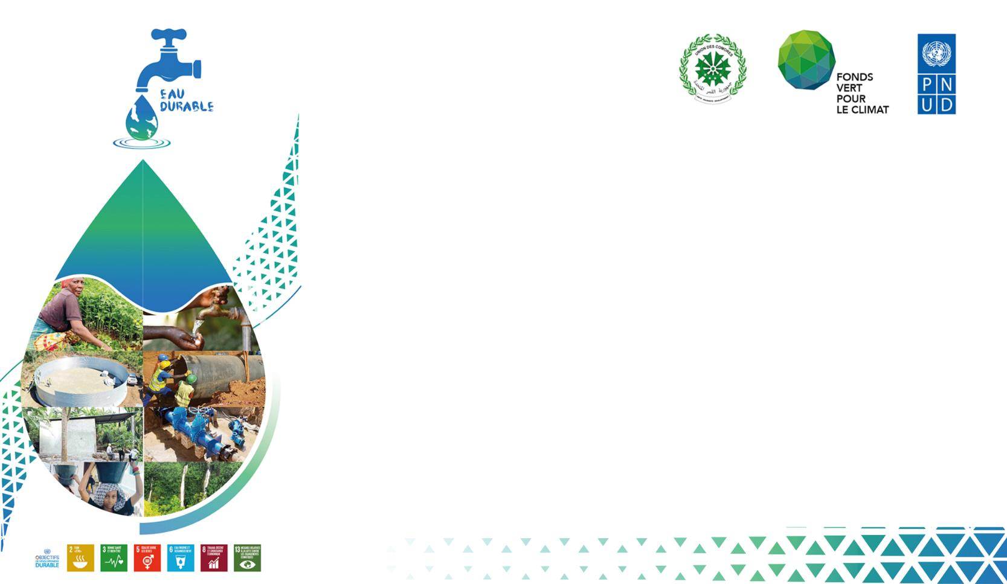

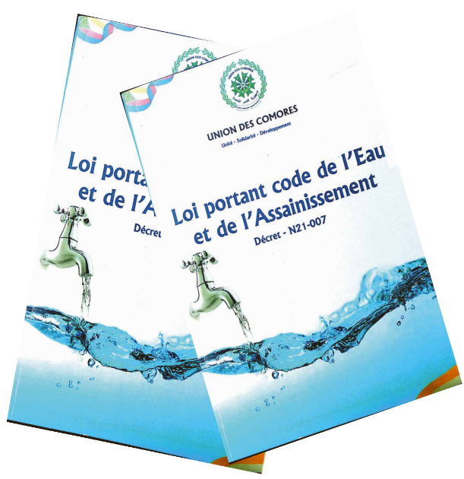
INTEGRATION OF IWRM AND WASH IN THE NEW WATER CODE – COMOROS-
SAID MOHAMED ASSUR :
SECRETAIRE GENERAL ADJOINT DU MINISTERE EN CHARGE DE L’EAU

Slide 29
I. BRIEF OVERVIEW OF THE WATER SECTOR IN COMOROS
PLAN DE PRESENTATION
II. PRESENTATION OF THE NEW WATER CODE IN COMOROS
IV. PERSPECTIVES FOR STRENGTHENING GIRE-WASH INTEGRATION IN THE NEW WATER REGULATION
III. INTEGRATION OF IWRM AND WASH IN THE COMORIAN WATER CODE

Slide 30
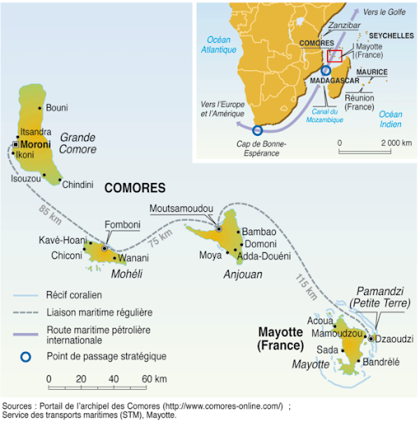
I. BRIEF OVERVIEW OF THE WATER SECTOR IN COMOROS
The Union of the Comoros is part of the Small Island Developing States located off the eastern coast of Africa, north of the Mozambique Channel, with a land area of the three islands of 1,862 km2 :
Capital : Moroni
Area: 1 862 km²

Slide 31
I. BRIEF OVERVIEW OF THE WATER SECTOR IN COMOROS (Suite…)
The water sector in Comoros is composed of three sources of supply:
  Surface water is almost non-existent on the island of Grande Comore due to the island's geological nature
  Groundwater is present in the center and south of Grande Comore,
  Rainwater collection is present on all three islands with an average annual potential of 1.5m3/m2 of catchment area, which can reach 4.8m3/m2 in the southwest of Grande Comore
The water sector is vulnerable due to:
  Low rainfall in certain regions
  Negative impacts of human activities (overexploitation, pollution from domestic and agricultural wastewater, deforestation in watersheds)

Slide 32
I. BRIEF OVERVIEW OF THE WATER SECTOR IN COMOROS (Fin)
The water sector is vulnerable due to:
Traditional practices that generate biological contamination
Poor waste management;
    Poor maintenance of water infrastructure;
    Natural disasters (tsunami, volcanic eruption),
  Salinization of wells due to water rise
    Community conflicts (destruction of structures)."

Slide 33

II. PRESENTATION OF THE NEW WATER CODE IN COMOROS
"In order to address the vulnerability of the various components of the Comorian water sector, the country has adopted a new water code after a long participatory process of consultations that received contributions from all stakeholders in the water sector: state structures, private sector and civil society.
The new water code was adopted on December 28, 2020, and then promulgated by presidential decree on January 30, 2021.
This new law on the water code is innovative in its provisions:
The conditions for effective implementation of integrated water resource management and their impact on natural resources and ecosystem services;
The public, parapublic, and private actors involved in water resource management, as well as their respective roles;

Slide 34
II. PRESENTATION DU NOUVEAU CODE DE L’EAU AUX COMORES (Suite et Fin)
Financing options for the water sector for knowledge, planning, use, and protection of water resources;
The obligation to obtain prior authorization for any form of exploitation of water resources regardless of their use and means;
The water police, which is now competent to punish waste, anarchic use of water, any behavior likely to cause pollution of resources, and any act that could compromise the sustainable and healthy management of water resources.
The various instruments and tools for integrated water resource management. These include planning and management instruments (master plans, water management plans...), sustainable financing (GIRE taxes and fees), prevention and repression of offenses (water police), as well as monitoring and evaluation (periodic evaluations)."

Slide 35
III. INTEGRATION OF IWRM AND WASH IN THE COMORIAN WATER CODE
In order to contribute to the achievement of SDG 6 in Comoros: Clean Water and Sanitation, the new Comorian Water Code places particular emphasis on integrating GIRE principles and WASH guiding principles.
Thus, the new Water Code proposes:
Integrated water resources management contributing to the achievement of sustainable development goals, including the reconciliation of economic development, equity, environmental protection, and the responsibility of the state to transmit quality ecosystems to future Comorian generations.
Regimes and conditions for various uses of water resources (agriculture and irrigation, tourism, environment and sanitation, industrial production, and hydropower, etc.)
Avenues for financing the water sector for knowledge, planning, utilization, and protection of water resources.

Slide 36
III. INTEGRATION GIRE ET WASH DANS LE CODE DE L’EAU COMORIEN (Suite et Fin)
Consideration given to strengthening all water resources governance functions through the clarification of roles and responsibilities of different actors and institutions involved in managing these resources, as well as the rights of populations in terms of water and sanitation, including the right to water and sanitation.
Rights and obligations of populations regarding water and sanitation.
Inclusion of women, youth, and other vulnerable groups in decision-making processes at all levels, in activities to protect and develop water resources, and in the management of hydraulic and sanitation infrastructure.

Slide 37
IV. PERSPECTIVES FOR STRENGTHENING GIRE-WASH INTEGRATION IN THE NEW WATER REGULATION
The institutional anchoring and operationalization of the new water code rely on:
The creation of a National Agency for Integrated Water Resources Management (ANGR), which will ensure "the implementation of integrated water resources management" at the national level.
The ANGR is vested with scientific, technical, administrative and research missions and "has the competence to mobilize parafiscal taxes from users to ensure sustainable financing of the water sector, in application of the user-payer and polluter-payer principles." At the island level, "regional antennas are created on each island, with competence over all the island's basins and coastal zones" according to the amendment introduced in the Commission.
The role of territorial collectives in water resources management
  Under the new law, municipalities will have the quality of delegated project manager for the public drinking water supply service. They entrust the management of the public distribution of drinking water to the national company responsible for water distribution under the current regulations.

Slide 38
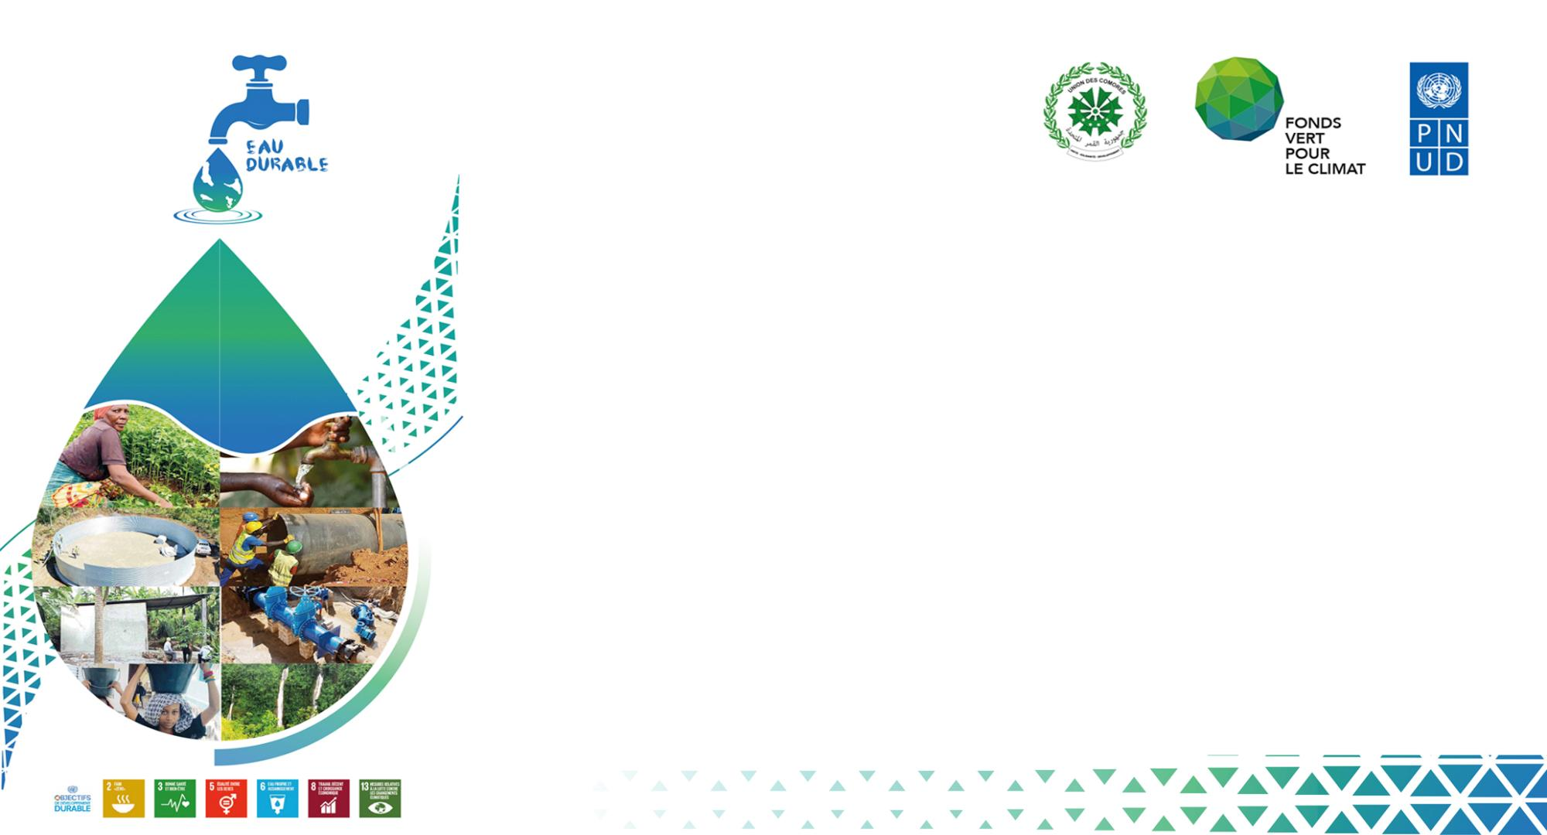


Q & A
Q & A

Slide 39
Case study 3
  Water Roadmaps (FAO)

Slide 40
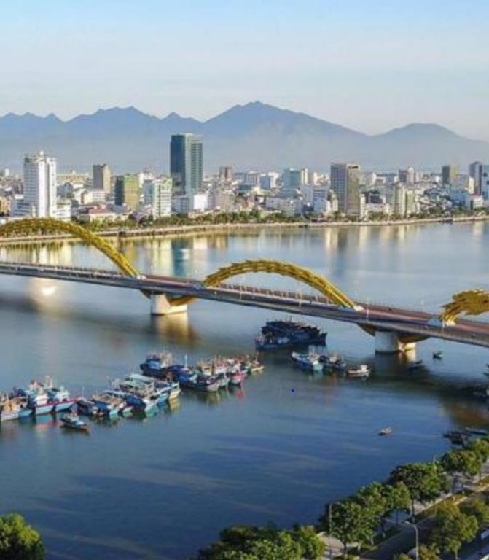
Case study 4
WASH and WRM integration: Putting theory into practice
Colin Herron, Senior Water Resources Management Specialist, Water Solutions for the SDGs
GWP
Notes:
Photo credit: Vn Economy, Oct. 31, 2021
Photo of Danang, Vietnam

Slide 41

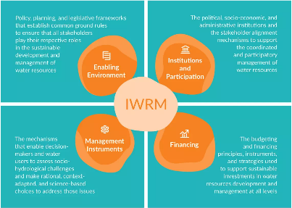
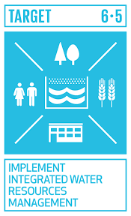
The SDGs and IWRM
The SDGs are “integrated and indivisible and balance the three dimensions of sustainable development: the economic, social and environmental” (Transforming our world: the 2030 Agenda for Sustainable Development, 2015)
IWRM is “a process that promotes the coordinated development and management of water, land and related resources in order to maximise economic and social welfare in an equitable manner without compromising the sustainability of vital ecosystems and the environment” (GWP, 2000)
SDG target 6.5 aims to implement IWRM at all levels by 2030. This is a process-related target, which can only be achieved by working across sectors (including but also going beyond SDG 6)

Slide 42
But how?
If that’s the challenge, how is GWP working with its partners to go beyond this siloed approach, in practice?
In many different ways (but I’ll just focus on two in the coming slides)

Slide 43

1. Global Water Leadership

Slide 44
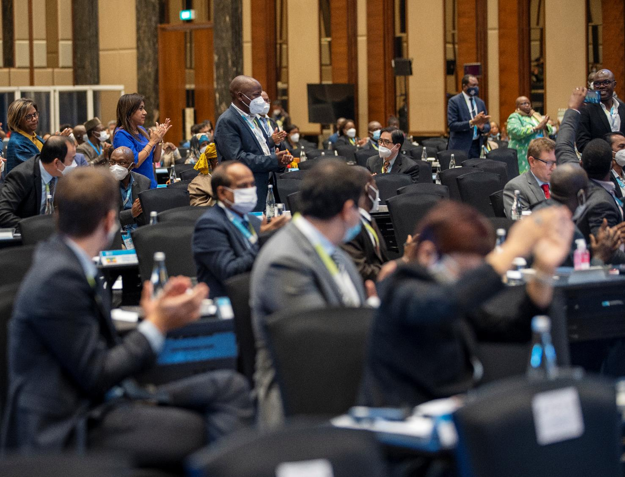
GWL vision
Governments in GWL countries will become international models for water leadership, demonstrating the socio-economic transformations that can be accomplished by making climate-resilient and gender-transformative water management and WASH services a political priority.
Notes:
Photo Credit: SWA, May 2022

Slide 45
Facilitate in-country multi-stakeholder change processes on IWRM (in parallel with UNICEF process for climate-resilient WASH services)
Joint initiation
of change process
& identification of barriers to progress in climate-resilient WRM and WASH
UNICEF –
WASH barriers
Joint conclusion of consultation and response strategy validation
Government
uptake and implementation
GWP –
IWRM barriers
Initial stakeholder consultations to identify the most problematic barriers to climate-smart water management (maximum 4 barriers)
Establish one working group per barrier
Working groups meet for 12 months to develop complete response strategies that include finance plans
Strategies validated and activated

Slide 46
Barriers grouped by SWA Building Block
Country | Working group titles
1. Policy or Strategy
Uganda | Strengthening legal, policy (and institutional) framework towards inclusive and resilient WRM
CAR | Weak application of policies and regulations
2. Institutional arrangements
Malawi | Lack of political will and water leadership
Tanzania | Overlapping legal and regulatory mandates impacting inter sectoral coordination
3. Finance
CAR | Low adequacy between the national budget allocated and the problems to be solved
Uganda | Limited finance towards inclusive and resilient WRM
4. Planning, monitoring & review
Rwanda | Limited knowledge/awareness by community and private sector on WRM issues & solutions
Palestine | Lack of KPIs and cascaded performance management for climate change impacts on water
5. Capacity
CAR | Lack and poor distribution of human resources
Rwanda | Limited technical capacity in water demand and supply management
6. Other (bottlenecks that, as currently defined, do not fit within SWA Building Blocks)
Palestine | Social reluctance towards accepting the reuse of treated wastewater
Tanzania | Inefficient utilization of water resources in agricultural activities

Slide 47
2. SDG 6 IWRM Support Programme

Slide 48
Country examples by IWRM dimension
Country | Action from the Action Plan | Links to which SDGs
1. Enabling environment
Kenya | Finalization of Water Towers Bill | 6.1, 6.5, 6.6, 15.1, 15.2
Cameroon | Support for the development of Local Water and Sanitation Plans in the communes | 6.1, 6.2, 6.5
2. Institutions and participation
Nicaragua | Strengthen permanent spaces for coordination and cooperation between municipalities that share basins | 6.1. 6.2, 6.5, 6.6, 6.a, 6.b
Armenia | Support communication managers to implement communication actions to instill new behaviors and attitudes in society | 6.1. 6.2, 6.4, 6.5, 6.b, 12.2
3. Management instruments
Guatemala | Generate forecasts on water supply and availability based on risk scenarios | 6.1, 6.4, 6.5, 13.1
Nepal | Develop a mechanism for data sharing by local governments, citizen’s groups, CBOs and school and operationalize a national database centre | 6.1, 6.2, 6.3, 6.5
4. Finance
Panama | Review water fee rates, as well as initial water use inspection fees | 6.1, 6.2, 6.5, 6.6
Kazakhstan | Update of water tariff policy | 6.1, 6.2, 6.5

Slide 49
Some final thoughts
All SDGs are inter-related, and NONE of them will be achieved unless we value and manage our water resources and services in an integrated way
There are endless frameworks, concepts and methodologies – we need to devote our energies to using the existing ones to advance towards our 2030 targets!
Breaking down the silos requires difficult conversations, including on trade-offs, and high-level political will at the national level
There are good examples of reduced fragmentation, and those can and should be shared, to stimulate others

Slide 50

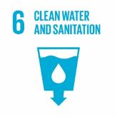




Thank you!
Colin Herron
Senior Water Resources Management Specialist, Water Solutions for the SDGs
Global Water Partnership
colin.herron@gwp.org

Slide 51
Panel discussion

Slide 52
Agenda
Panel discussion (UNICEF, UNDP, SIWI, FAO, GWP)
  What would be the next steps for implementation of this framework?
  What challenges do we need to overcome?

Slide 53
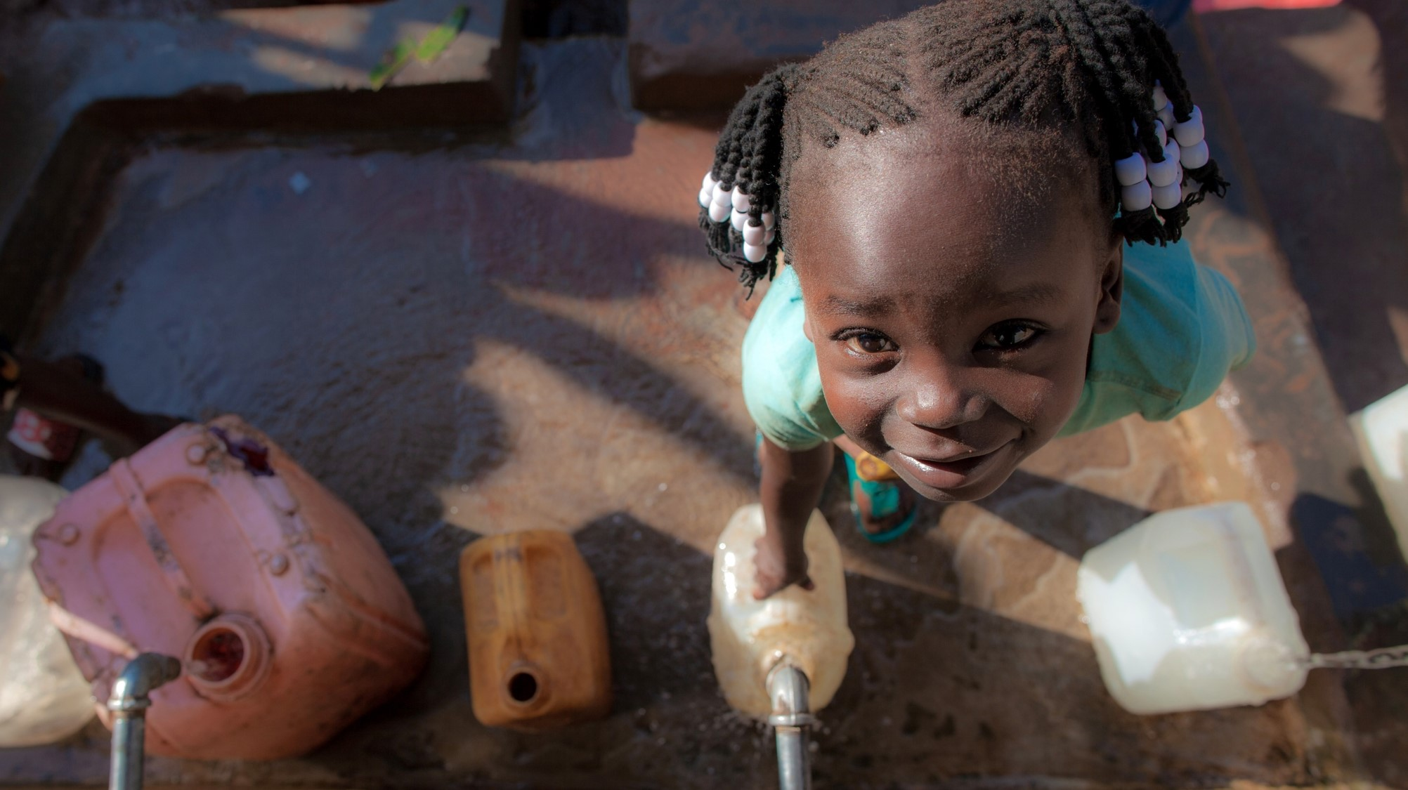
Closing remarks
Farai Tunhuma, UNICEF

