Slide 1
Strengthening the national Drought governance, Management, and capacities in Jordan

Slide 2
Jordan is One of the most five water scarce countries in the world.
Jordan has annual water balance deficit of approximately 20 percent.
The deficit is further exacerbated by the huge influx of Syrian refugees (20% of the total population),
the fluctuation of the precipitation trends, the increase of drought frequencies and severity in the last decades

Slide 3
Total rainfall volume over Jordan (1938-2014)

Slide 4
The severe drought occurred in Jordan in 1998-2000 contributed to raise awareness about the country’s vulnerability to severe drought
The existing governance structure of drought management in Jordan is very primitive
Shortage of key institutional and individual capacities
Lack of comprehensive drought early warning system

Slide 5
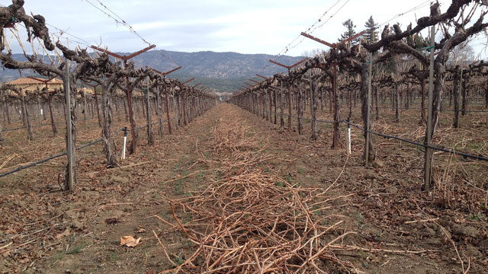
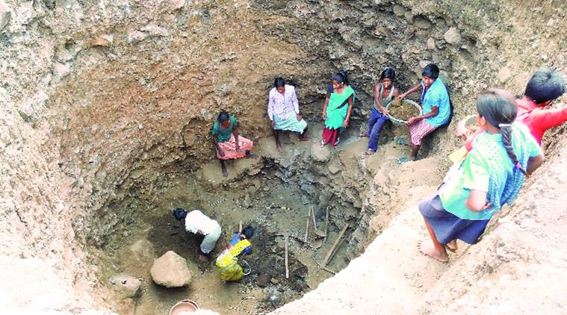
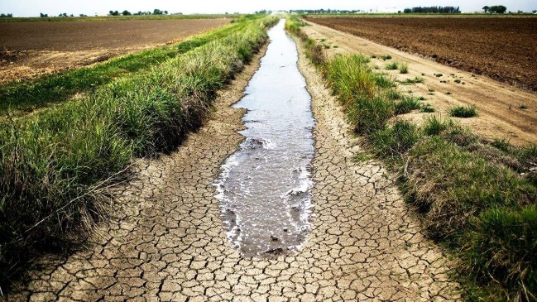
Objective
To strengthen the national drought governance system in Jordan, and promote more systematic approach to drought response planning and management
In 2016

Slide 6
Outputs
(From Governance to Implementation)
Clear institutional setups for drought management; (MWI 2018)
National policy statement on drought management in the water sector (MWI 2018)
Drought monitoring and drought early warning system (UNDP, MWI 2016)
Training programme designed and implemented (UNDP)

Slide 7
Awareness raising program on drought hazards and the underlying causes of its impacts (UNDP)
Drought vulnerability assessment and validation (UNDP, MWI)
Drought mitigation and response measures are identified and mainstreamed
Localize the drought adaptation through pilot projects (UNDP)

Slide 8
Institutional Set ups
NCSCM
Meteorological Department
MoWI
MoEnv
National Drought Committee
MoAgr
Drought Management Unit
MoH
Drought Early Warning System
Vulnerability & Impact Assessment
Mitigation & Response

Slide 9
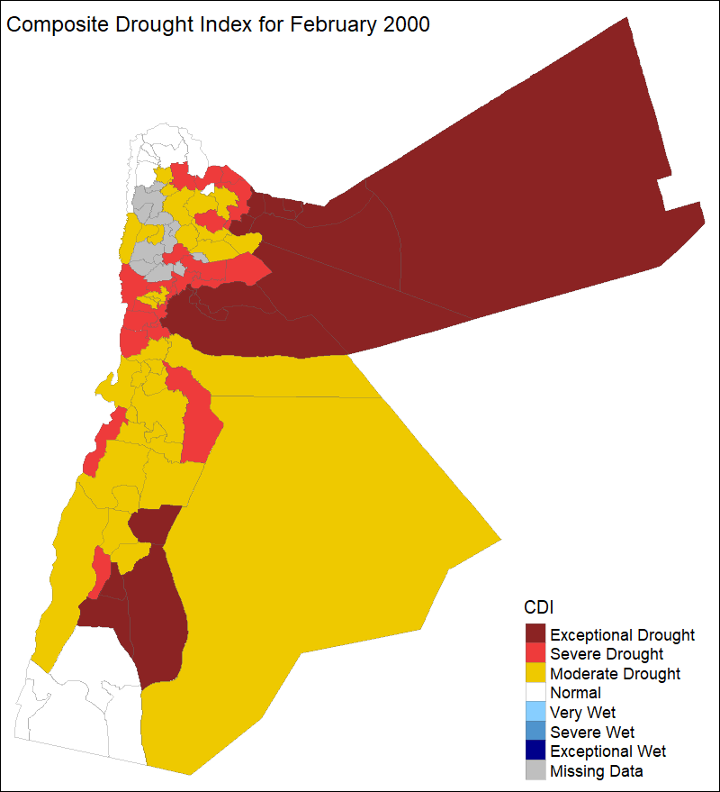
Drought Early Warning System
Track, assess and deliver relevant information concerning climatic, hydrologic and water supply conditions and trends.
Weather Forecasting Component
Drought Monitoring Component
Notes:
Monthly accumulated rainfall 40% Monthly temperature 20% Monthly NDVI 20% Monthly soil moisture 20%

Slide 10
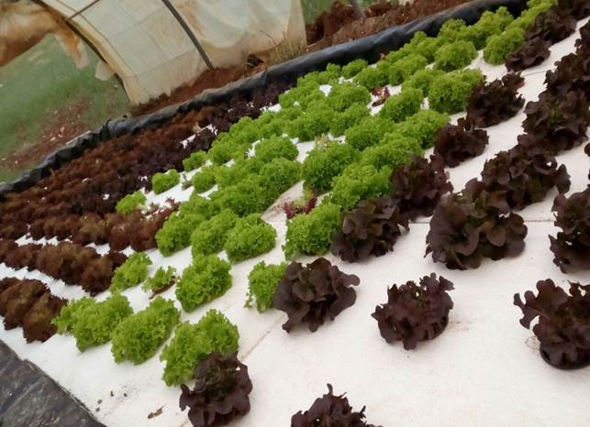
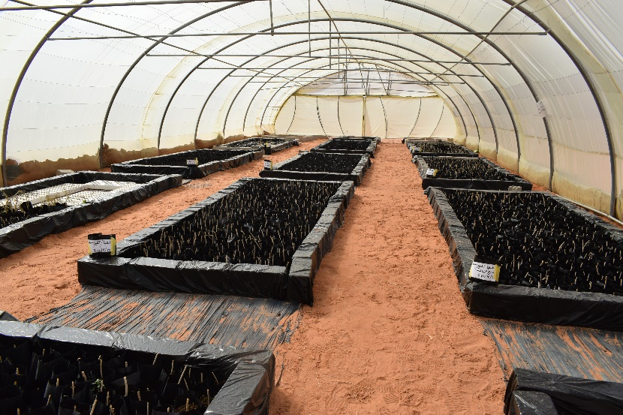
Endorsement of Drought Policy Statement in Water Sector
&
Localizing Drought Adaptation Measures

Slide 11
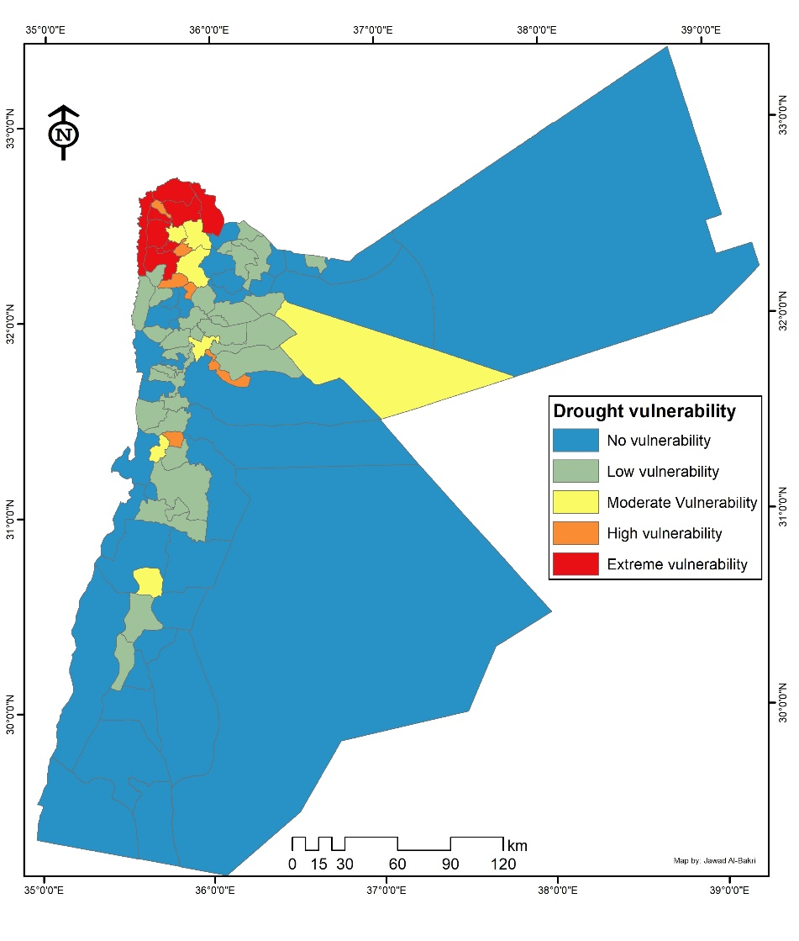
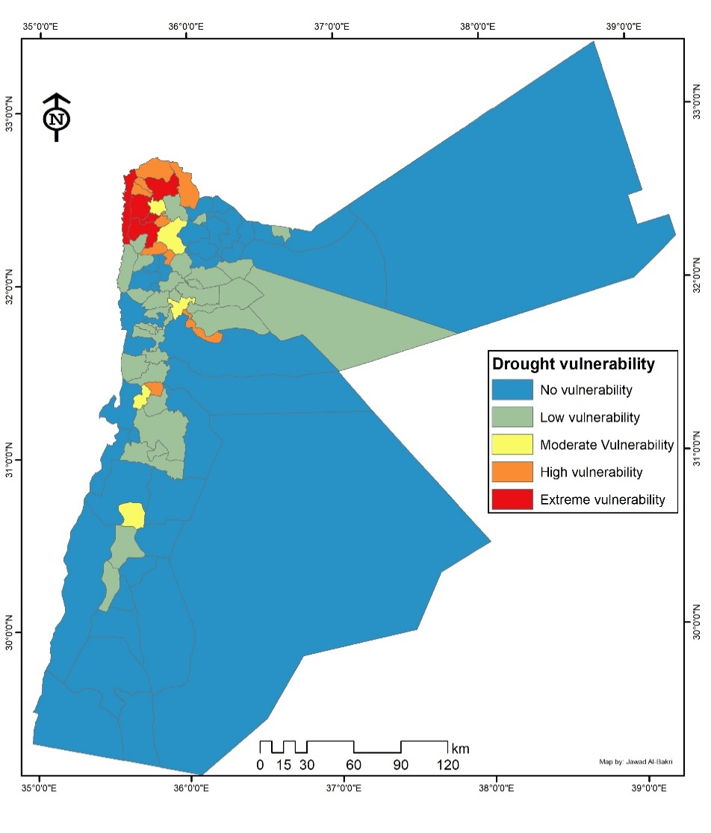
Drought Vulnerability Assessment
Comparison between the vulnerability at the subdistrict levels with inclusion (left) and exclusion (right) of the Syrian refuges in the total population

Slide 12
Drought Vulnerability Assessment
The Drought Vulnerability Assessment revealed that approximately 2.5 million people of the northwest governorates of Ajloun, Irbid and Jerash are extremely vulnerable to drought due to their high sensitivity and exposure and the low adaptive capacity
The drought vulnerability assessment also indicated that the occurrence of frequent droughts and adverse climate change will drive climate displacement towards the capital city of Amman as more secured water sources are existing, migration from rural to urban is also expected and about 15% of the country’s farmers will leave their lands or shift their use from agriculture to other uses

Slide 13
Ongoing Activities
Validate the drought vulnerability map in Water Sector focusing on the Yarmouk, Amman-Zarqa, Mujib and Azraq underground basins
Valuate the economical and social impacts of drought on the targeted underground water basins
Set up national assessment guidelines in the water sector based on the findings of the dialogues at groundwater basin levels
Prepare the drought mitigation and response priority list for each targeted basin
Facilitate-multi stakeholders dialogue on the national assessment guidelines and mitigation and response priority list
Pilot one of the mitigation and response measures at municipal level

Slide 14
Thank you very much

